Slide 1
MA3077 Operational Research Lecture 6 – Shadow prices and sensitivity analysis
Dr Marco Fasondini

Slide 2
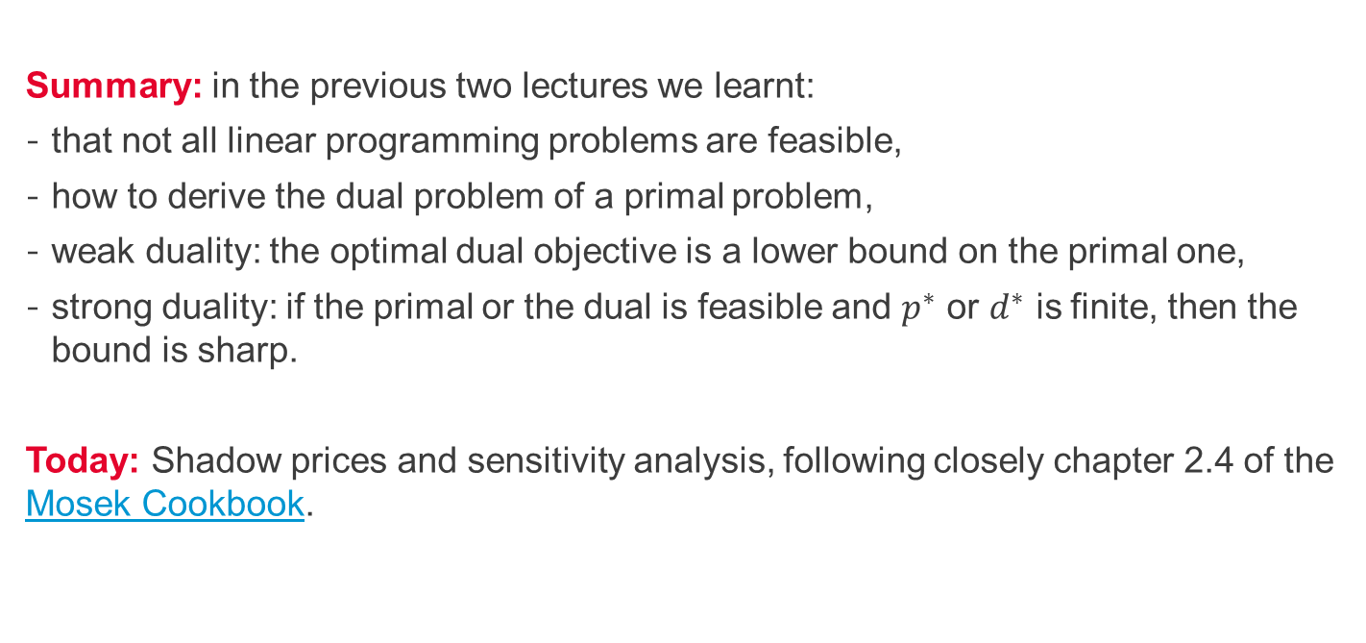
Recapitulation and lecture outline
Summary: in the previous two lectures we learnt:
that not all linear programming problems are feasible,
how to derive the dual problem of a primal problem,
weak duality: the optimal dual objective is a lower bound on the primal one,
strong duality: if the primal or the dual is feasible and $p^{∗}$ or $d^{∗}$ is finite, then the bound is sharp.
Today: Shadow prices and sensitivity analysis, following closely chapter 2.4 of the Mosek Cookbook.

Slide 3
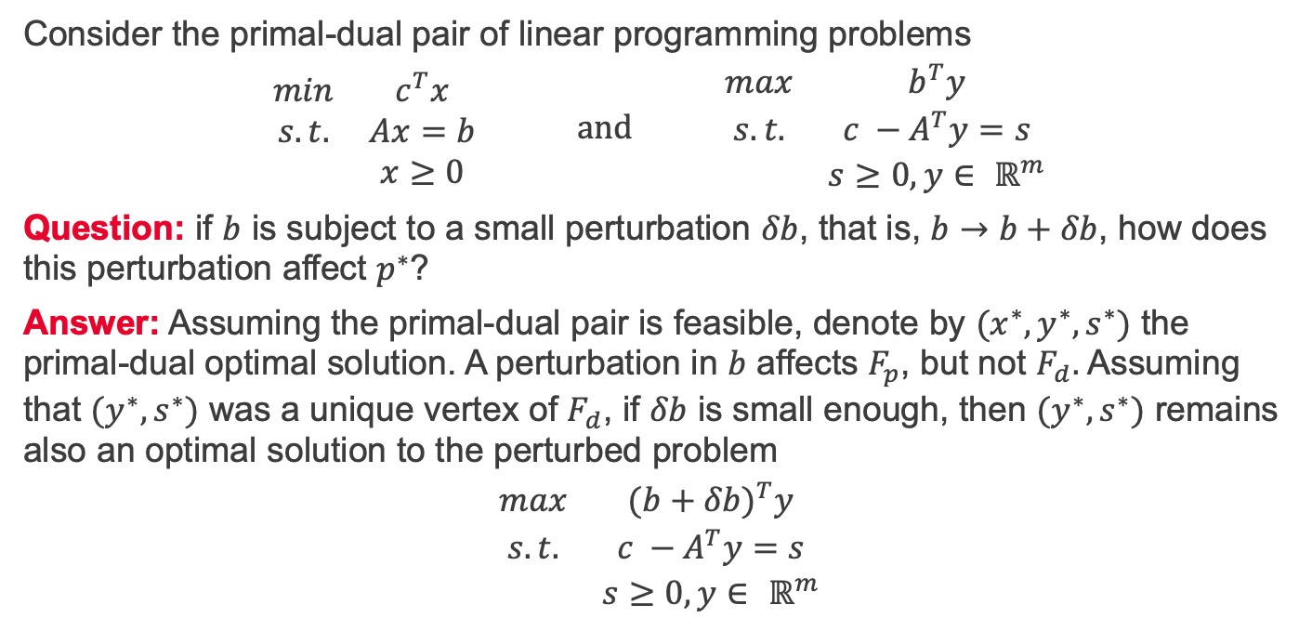
Shadow prices 1/2
Consider the primal-dual pair of linear programming problems
$$\begin{matrix}min & c^{T}x \\ s.t. & Ax=b \\ & x≥0\end{matrix} and \begin{matrix}max & b^{T}y \\ s.t. & c −A^{T}y=s \\ & s≥0, y∈ ℝ^{m}\end{matrix}$$
Question: if $b$ is subject to a small perturbation $δb$, that is, $b→b+δb$, how does this perturbation affect $p^{∗}$?
Answer: Assuming the primal-dual pair is feasible, denote by ${(x}^{∗}, y^{∗},s^{∗})$ the primal-dual optimal solution. A perturbation in $b$ affects $F_{p}$, but not $F_{d}.$ Assuming that ${(y}^{∗},s^{∗})$ was a unique vertex of $F_{d}$, if $δb$ is small enough, then ${(y}^{∗},s^{∗})$ remains also an optimal solution to the perturbed problem
$$\begin{matrix}max & {(b+δb)}^{T}y \\ s.t. & c −A^{T}y=s \\ & s≥0, y∈ ℝ^{m}\end{matrix}$$

Slide 4
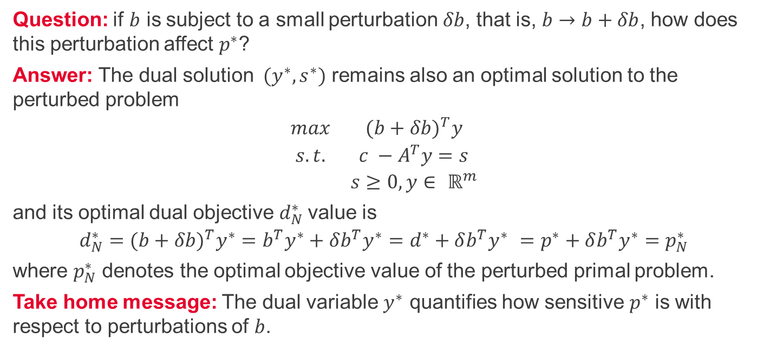
Shadow prices 2/2
Question: if $b$ is subject to a small perturbation $δb$, that is, $b→b+δb$, how does this perturbation affect $p^{∗}$?
Answer: The dual solution ${(y}^{∗},s^{∗})$ remains also an optimal solution to the perturbed problem
$$\begin{matrix}max & {(b+δb)}^{T}y \\ s.t. & c −A^{T}y=s \\ & s≥0, y∈ ℝ^{m}\end{matrix}$$
and its optimal dual objective $d_{N}^{∗}$value is
$${{d_{N}^{∗}=(b+δb)}^{T}y^{∗}=b}^{T}y^{∗}+δb^{T}y^{∗}=d^{∗}+δb^{T}y^{∗} =p^{∗}+δb^{T}y^{∗}=p_{N}^{∗}$$
where $p_{N}^{∗}$ denotes the optimal objective value of the perturbed primal problem.
Take home message: The dual variable $y^{∗}$ quantifies how sensitive $p^{∗}$ is with respect to perturbations of $b$.

Slide 5
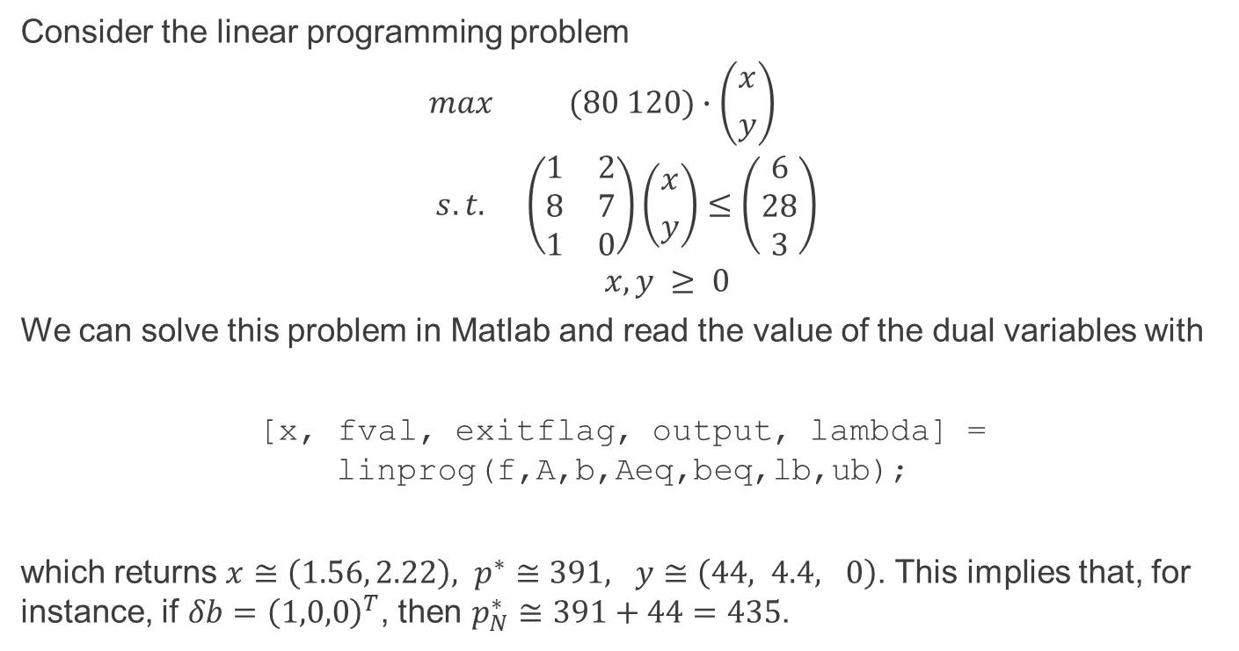
Shadow prices – example (see OR06_shadow_prices.m)
Consider the linear programming problem
$$\begin{matrix}max & (80 120)∙\left({x \atop y}\right) \\ s.t. & \left(\begin{matrix}1 & 2 \\ 8 & 7 \\ 1 & 0\end{matrix}\right)\left({x \atop y}\right)≤\left(\begin{matrix}6 \\ 28 \\ 3\end{matrix}\right) \\ & x,y ≥ 0 \end{matrix}$$
We can solve this problem in Matlab and read the value of the dual variables with
[x, fval, exitflag, output, lambda] = linprog(f,A,b,Aeq,beq,lb,ub);
which returns $x≅\left(1.56, 2.22\right), p^{∗}≅391, y≅\left(44, 4.4, 0\right)$. This implies that, for instance, if $δb={\left(1,0,0\right)}^{T}$, then $p_{N}^{∗}≅391+44=435$.

Slide 6
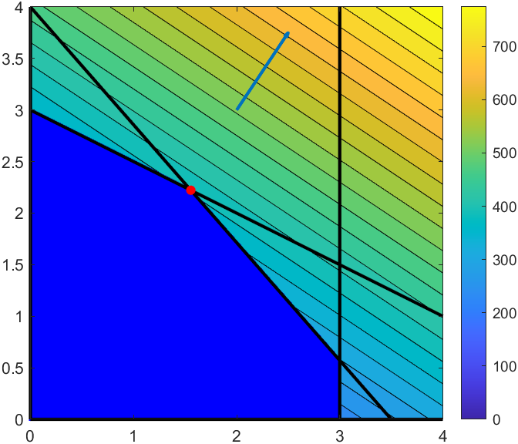
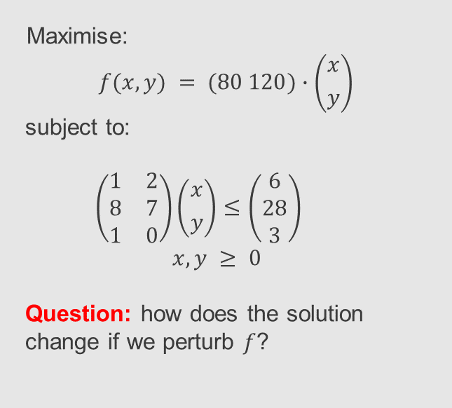
Sensitivity analysis – pertubations of $f$
Maximise:
$$f(x,y) = (80 120)∙\left({x \atop y}\right)$$
subject to:
$$\left(\begin{matrix}1 & 2 \\ 8 & 7 \\ 1 & 0\end{matrix}\right)\left({x \atop y}\right)≤\left(\begin{matrix}6 \\ 28 \\ 3\end{matrix}\right)$$
$$x,y ≥ 0$$
Question: how does the solution change if we perturb $f$?

Slide 7
Perturbing the objective function (see OR06_sensitivity_analysis.mlx and OR06_feasible_region.m)

Slide 8
Performing sensitivity analysis
Unfortunately, Matlab's linprog does not perform sensitivity analysis. There are alternative toolboxes e.g., Mosek, but setting them up can be technical and it's beyond the scope of this lecture.
Instead, sensitivity analysis in R or MS Excel is straightforward. On Blackboard you can find an R-script to perform sensitivity analysis (based on lpsolve). If you prefer MS Excel instead, here is a good tutorial. For this example, we get:
Finally, for an interesting critique of sensitivity analysis, read S. W. Wallace.
Objective's coefficients | Sensitivity analysis – lower bound | Sensitivity analysis – upper bound
80 | 60 | 137
120 | 70 | 160

Slide 9
Summary and self-study
Summary: today we learnt
the interpretation of the dual variables as shadow prices,
how to retrieve the dual variables from linprog,
how perturbations in the objective function can affect the location of the optimum.
Self-study: Analyse the shadow prices of your own linear programming problem. For example, you could use the problem for self-study section in OR01_linear_programming.pptx .

